Slide 1
Welcome to 4th grade

Slide 2
My Name is Ms. Hinkel
Room 312
Put up backpacks
Take your seats for attendance
This Photo by Unknown Author is licensed under CC BY

Slide 3
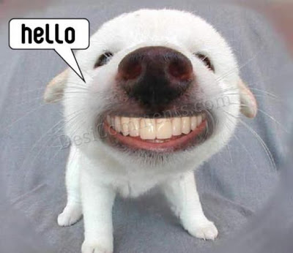
Meet & Greet
Say “Hello” to your table and introduce yourself
This Photo by Unknown Author is licensed under CC BY-NC-ND

Slide 4
Morning Meeting
Come to the carpet for Morning Meeting
Classroom Rules and Consequences
Classroom name/theme
This Photo by Unknown Author is licensed under CC BY

Slide 5
It’s Game Time!
Hands Up Pair Up
This Photo by Unknown Author is licensed under CC BY-SA

Slide 6
YOU ARE DOING GREAT!
This Photo by Unknown Author is licensed under CC BY-NC-ND

Slide 7
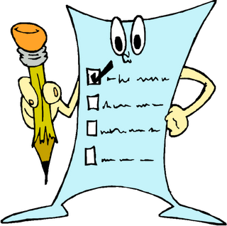
Schedule For Today
Schedule for today and the week
Goals/Expectations
Why should I care?
This Photo by Unknown Author is licensed under CC BY-SA-NC

Slide 8
Reading Time
What should it look like?
Goals
Rules for the library
Worksheet
This Photo by Unknown Author is licensed under CC BY-NC-ND

Slide 9
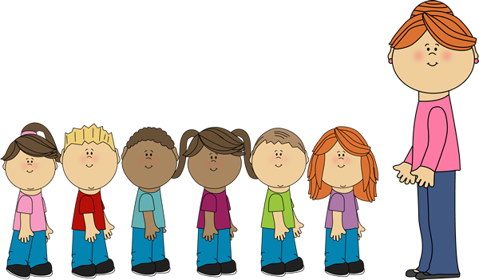
Line Up
Rules and expectations
Practice makes perfect
This Photo by Unknown Author is licensed under CC BY-NC-ND

Slide 10
Writing
Lesson for the day/week
Expectations
What would you do if you were given a minion for a week?
This Photo by Unknown Author is licensed under CC BY-SA-NC

Slide 11
Sharing Writing
When students share
Rules and expectations
Be courteous!
This Photo by Unknown Author is licensed under CC BY-NC-ND

Slide 12
Snack Break!
This Photo by Unknown Author is licensed under CC BY-SA

Slide 13
Library
Review rules
Let’s go!
This Photo by Unknown Author is licensed under CC BY-NC-ND

Slide 14
Let's Get Creative
Name tags!
Get supplies
Be kind
Be appropriate
This Photo by Unknown Author is licensed under CC BY-SA

Slide 15
Lunch!
Review lunch and recess rules
How to come back to class
Bathroom Break!
Let’s eat!
This Photo by Unknown Author is licensed under CC BY-ND

Slide 16
Math
Expectation and rules
Schedule for the week
Worksheet
This Photo by Unknown Author is licensed under CC BY

Slide 17
Make Up Time
Unfinished work
Rules for this time
What if I do have unfinished work?
Reading
Draw

Slide 18
YOU MADE IT!
Review bus/pickup rules
Clean up the classroom
Line Up
Bus line
Pickup line
This Photo by Unknown Author is licensed under CC BY-NC-ND

Slide 19
CAN'T WAIT TO SEE YOU TOMORROW!
This Photo by Unknown Author is licensed under CC BY-SA-NC

